Slide 1
Depth-wise Separable convolutions
https://machinelearningmastery.com/using-depthwise-separable-convolutions-in-tensorflow/
21-CP-26

Slide 2
Proposed Methodology
Depth-wise separable convolution is a technique used to make convolutional neural networks (CNNs) more efficient while maintaining performance, especially for computer vision.
In a regular convolution, each filter is applied to all input channels (e.g., RGB for colored images) and combines the features across all these channels.
However, in depth-wise separable convolution, this process is split into two smaller steps:
Depth-wise Convolution: Each filter is applied only to a single input channel. So, for an image with three channels (red, green, blue), three different filters are applied, one for each channel.
Pointwise Convolution: After the depth-wise convolution, a 1x1 convolution is applied to combine the output of the depth-wise step across all channels. This helps to mix features from different channels.
The key advantage is that depth-wise separable convolutions require fewer computations and parameters, making the model faster and lighter, especially on tasks with large datasets or limited computational resources.

Slide 3
Part 1 Loading dataset
CIFAR-10 dataset. 60,000 images in total:
X_train contains 50,000 training images (32x32 pixels, RGB color:3).
y_train contains the labels of these images.
X_test contains 10,000 test images.
y_test contains the labels for those test images.
Part 2 Normalizing & One Hot Encoding dataset
From a range of 0-255 to a arrange of 0-1
One hot Encoding means for a given label considering that label to be vector 1 and all else become vector 0
If the label is 3 ("bird"), it will be converted into a vector like [0, 0, 0, 1, 0, 0, 0, 0, 0, 0] (a vector of length 10).

Slide 4
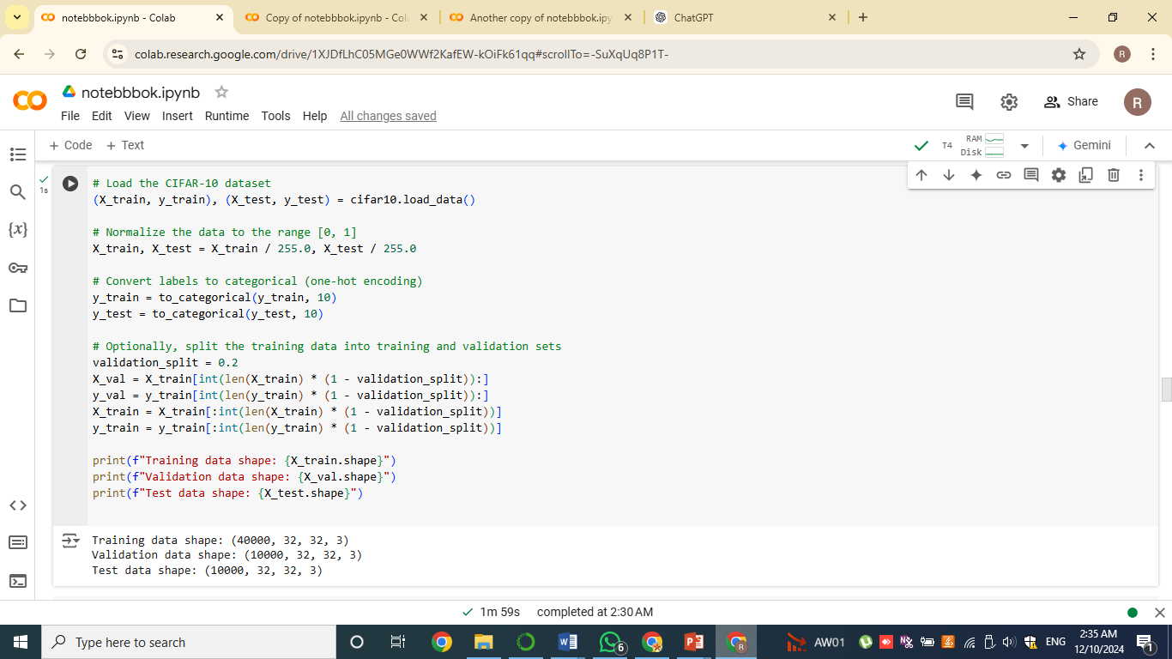

Slide 5
Part 3 Model using vgg-architecture
Convolution Layers
Layer 1 The model starts with an input layer that expects images of size 32x32 pixels with 3 color channels (RGB).
Layer2:This is a 2D convolutional layer with 64 filters of size 3x3. It applies the ReLU activation function and uses 'same' padding (output image size is the same as input).
Layer3 This is a max-pooling layer that down-samples the feature maps by selecting the maximum value from each 2x2 window
Similarly 2 other blocks of 2 Convolution layer and Max-Pooling layer
Flatten layer
This layer flattens the 3D feature maps (height, width, channels) into a 1D vector. It prepares the feature maps to be fed into the fully connected (dense) layers.

Slide 6
Part 3 Model using vgg-architecture
3.Dense Layers
Dense(512, activation='relu'):A fully connected layer with 512 neurons and ReLU activation. This layer learns high-level representations of the input data.
Dropout(0.5):This is a dropout layer that randomly sets half (50%) of the inputs to zero during training to prevent overfitting
Dense(10, activation='softmax'):The output layer with 10 neurons, one for each of the 10 classes in the CIFAR-10 dataset. The softmax activation function is used to output the probabilities of each class. The output values sum to 1.
4 Create and Compile Model
Compile model using Adam optimizer, an optimization algorithm that adapts learning rates based on the gradients.Loss categorical_cross entropy for multiple classes

Slide 7
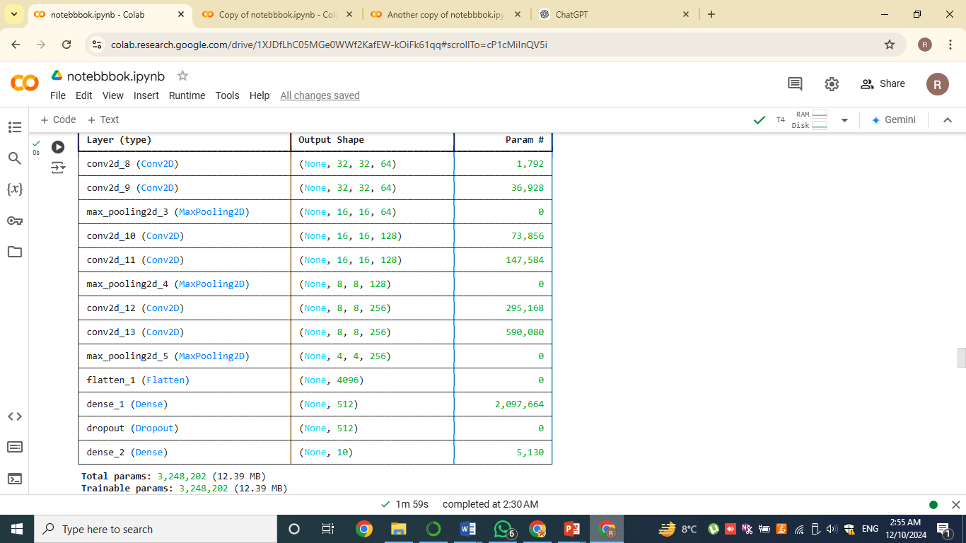

Slide 8
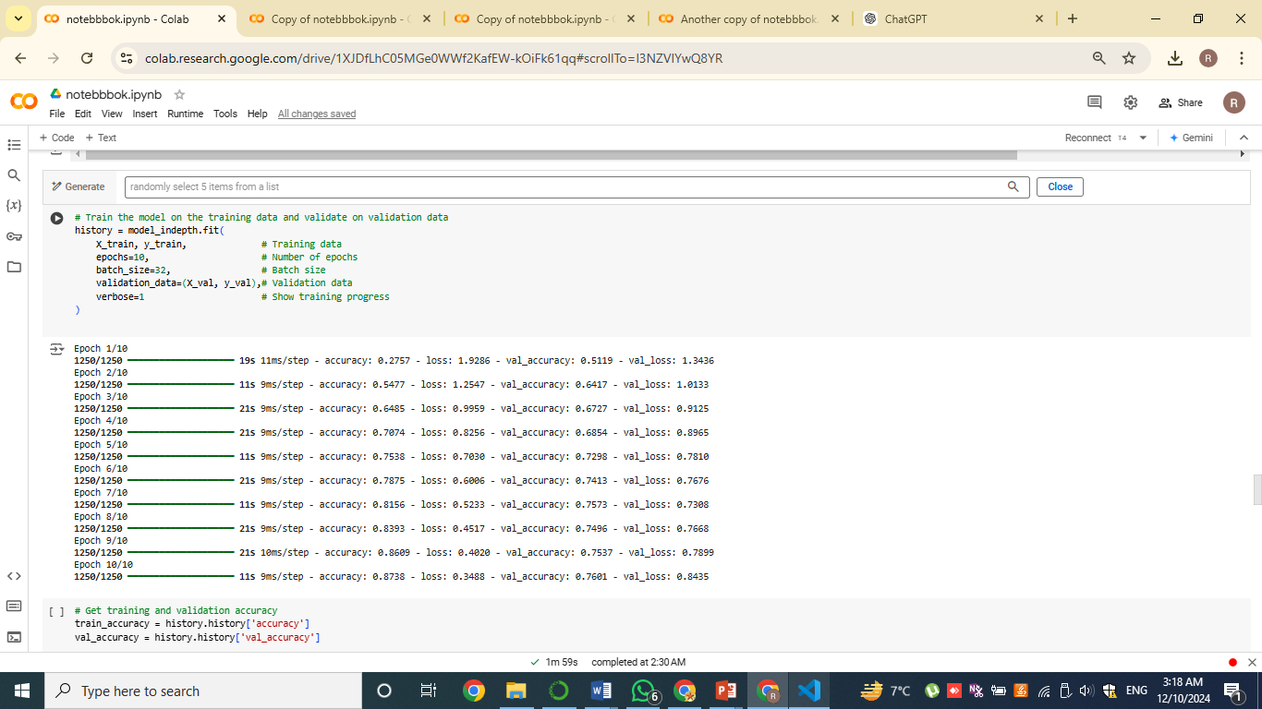
Part 4 Train model
The model is trained using thefit() method, which involves providing the training data (X_train and y_train)
During training, the model processes the training data in small batches, with each batch containing 32 images.
This process repeats for 10 epochs, allowing the model to learn and adjust its weights based on the input data.
After each epoch, the model evaluates its performance on the validation set (X_val and y_val) to monitor its ability to generalize to unseen data.

Slide 9
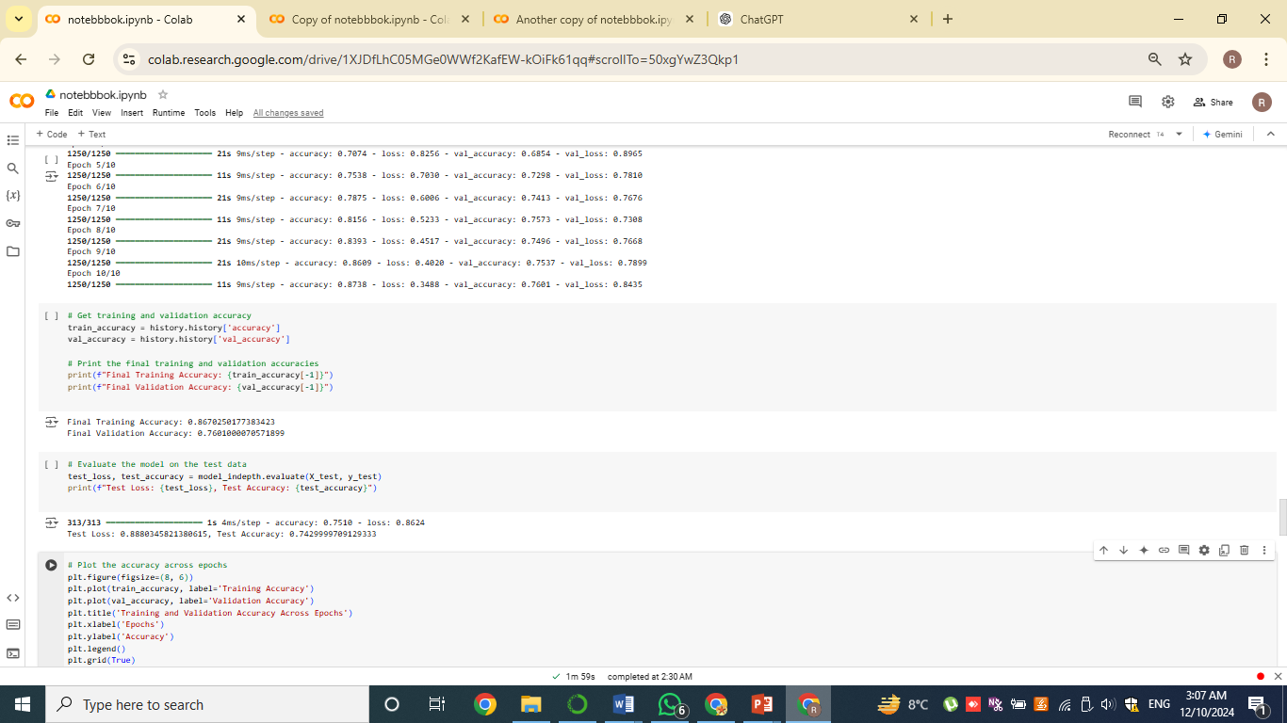
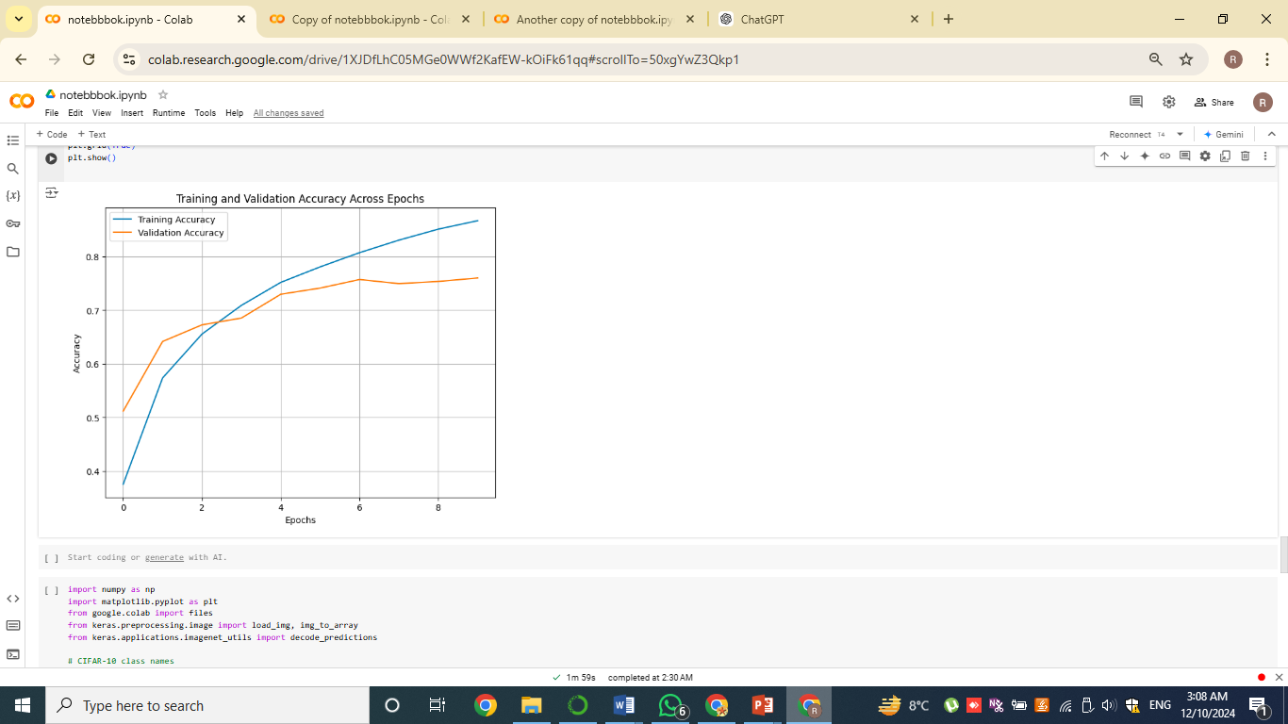
Part 5 Training & Validation accuracy

Slide 10

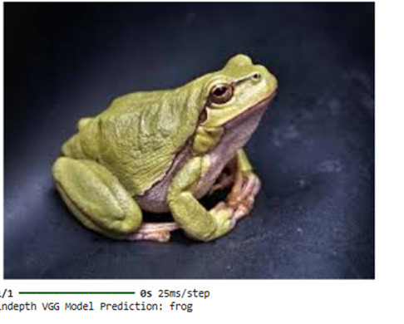
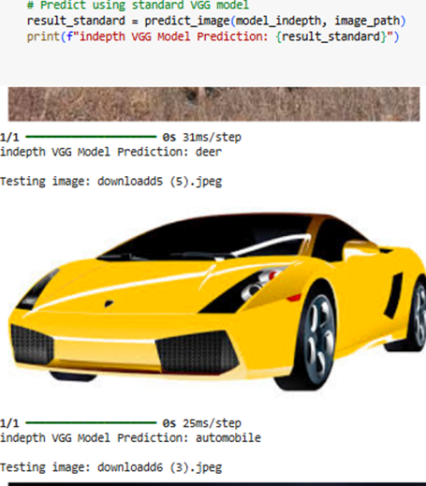
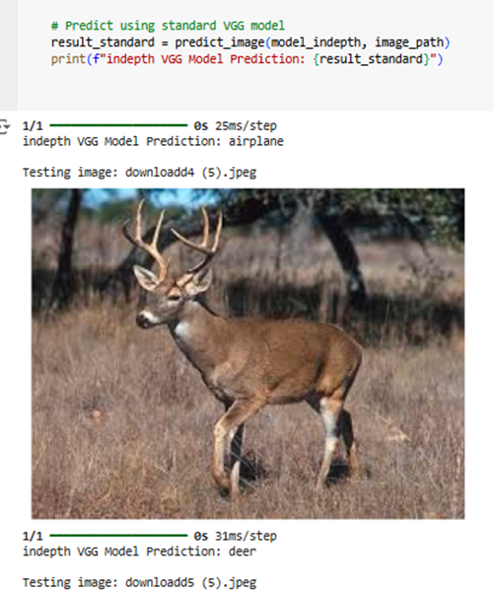
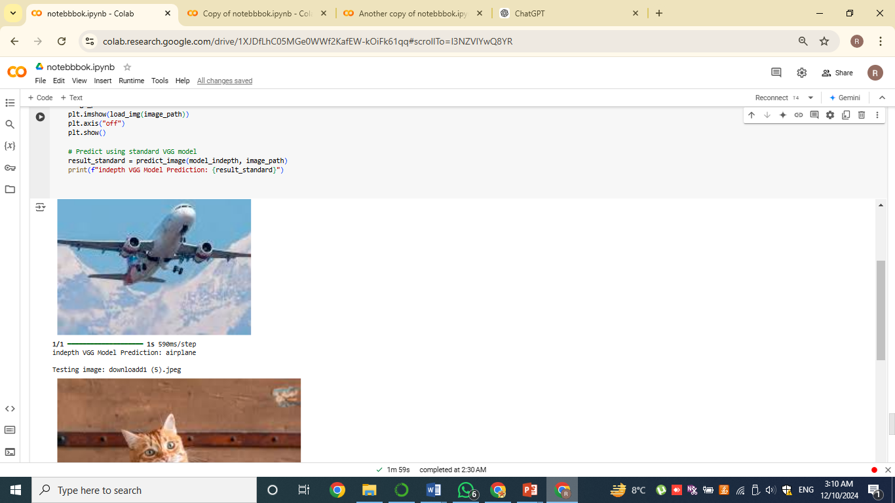
Image Prediction using Model

